Slide 1
Global Health (GLBHL) Minor
Dr. Melina Czymoniewicz-Klippel
Lecturer & Global Health Minor Coordinator
Department of Biobehavioral Health

Slide 2
GLBHL Minor
Penn State’s GLBHL minor is an interdisciplinary 18-credit (soon to be 21-credit) program designed for undergraduate students who seek a broad and flexible set of skills for understanding and addressing contemporary health challenges that transcend national boundaries.

Slide 3
GLBHL minor demographics
75-100 inquiries per semester
3 application rounds since inception of minor in 2010
61 student applications, admitted 44 students
Represent18 majors + 10 minors
15 are SHC students (34%)
Average GPA at the time of application = 3.63
Graduated 14 students

Slide 4
The “typical” wannabe GLBHL student
Female
Health or science major
Moving away from medical career
Wants to “help” others
Wants to travel
Previous exposure to the developing world

Slide 5
Come to an information session!
Held 2+ times per semester
Dates and locations distributed via email and hardcopy flyers
Overview of the GLBHL minor – theoretical framework, curriculum (including fieldwork), application process
Opportunity to interact with current students

Slide 6
Schedule an advising appointment
Schedule by contacting one of the BB H staff:
Ph: 814-864-7256
In person: 219 BB H Building
Students provided the opportunity to ask more specific, individual questions
Students provided copy of the application materials by email

Slide 7
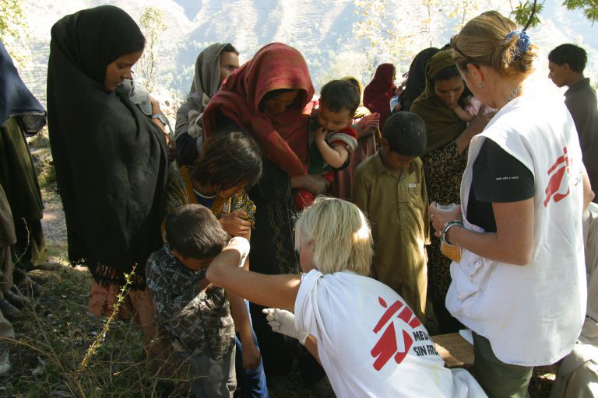
What is global health?

Slide 8
Global Health Minor
Objectives:
Have a greater critical understanding of the complexity of contemporary global health issues;
Be able to critique the theoretical frameworks and concepts used to inform global health policies and programs in a variety of settings;
Display enhanced personal and professional skills in inter-cultural communication and competence; &
Be better prepared for occupations that demand interdisciplinary and global thinking skills and perspectives.

Slide 9
But, how?
Coursework
- Core classes
- Supporting classes
Global fieldwork experience
Global career

Slide 10
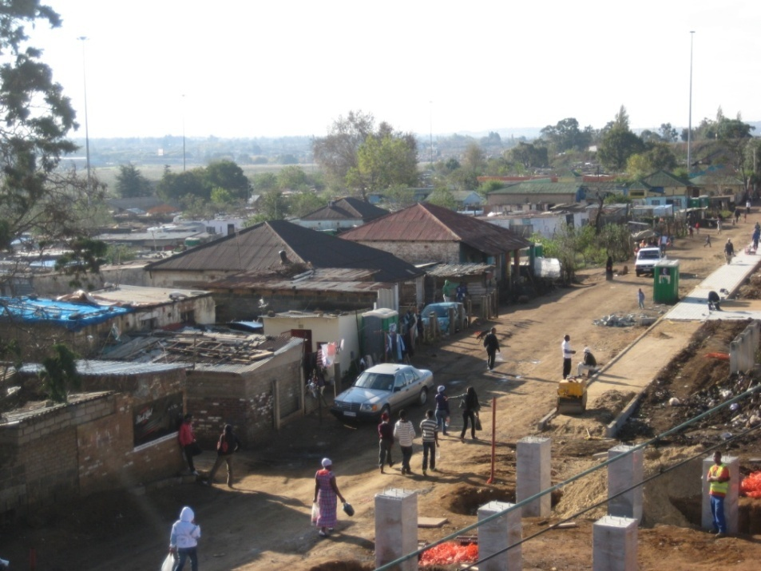
In the field… South Africa, 2012

Slide 11
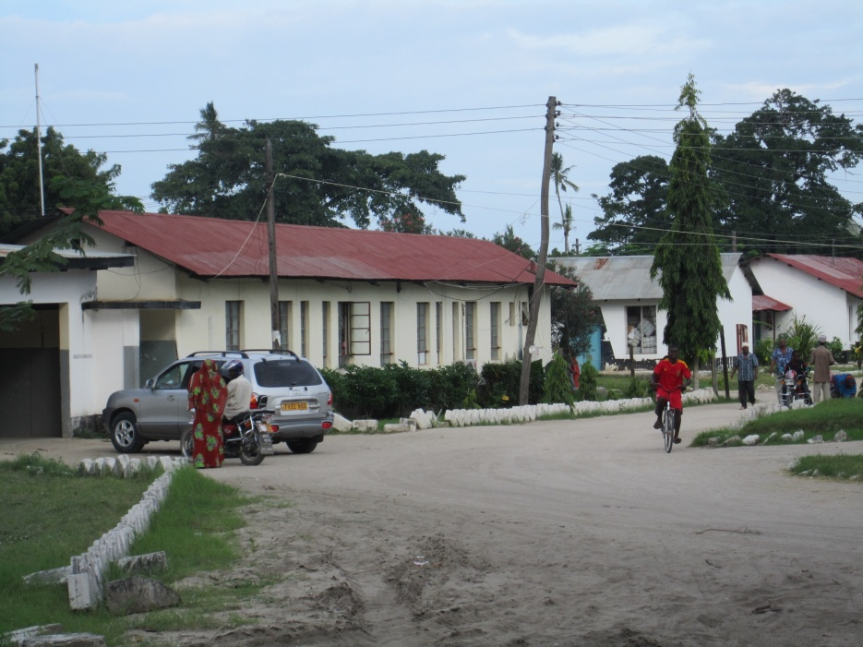
In the field… Tanzania, 2012

Slide 12
Global health careers

Slide 13
Still interested?
Eligibility Criteria:
Enrolled at the University Park campus
Have declared a major area of study (students from any Department or College may apply)
At least 5th semester standing at the time of entering the minor
Be willing to plan, fund (fully or partially), and engage in the fieldwork experience

Slide 14
Still interested?
Applications are accepted once per year in the Spring semester
This year’s deadline = 15 February, 2013

Slide 15
Want to know more?
Go to…
http://bbh.hhdev.psu.edu/globalhealth/
Contact…
Dr. Melina Czymoniewicz-Klippel
814-865-4672 or mtc16@psu.edu

