Slide 1
Discovering the Globe
Human Rights, Cultural Forms, and Global Perspectives

Slide 2
Today’s topics
Why Teach Global Perspectives?
Pedagogical Challenges
Psychological
Cultural and Social
Teaching these issues in a course on the Culture of Human Rights

Slide 3
Why teach global perspectives?
Global Economy
Movement of People
Climate Change and Sustainability
Increasing Challenges of Developing Nations
International Conflicts and National Security
Technology and a Networked Globe
Global Citizenship

Slide 4
Psychological Challenges
actor-observer bias
mere-exposure effect
outgroup homogeneity bias
negativity bias
focusing on worse-off others to comfort ourselves
confirmation bias
cognitive dissonance
just-world phenomenon

Slide 5
Actor-Observer Bias
refers to a tendency to attribute one's own action to external causes, while attributing other people's behaviors to internal causes.
The actor-observer bias tends to be more pronounced in situations where the outcomes are negative.
Essentially, people tend to make different attributions depending upon whether they are the actor or the observer in a situation (Jones & Nisbett, 1971).
Source: http://psychology.about.com/od/aindex/g/actor-observer.htm

Slide 6
Mere-exposure Effect
People feel a preference for people or things simply because they are familiar.
Has no basis in logic.
Makes “foreign” cultures uncomfortable and new behaviors seems strange.

Slide 7
Outgroup Homogeneity Bias
One’s perception of out-group members as more similar to one another than are in-group members.
Thus "they are alike; we are diverse".
People have a more differentiated cognitive representation of in-groups than of out-groups. Makes it hard for us to see out-groups as complex.
The out-group homogeneity bias relates to social identity theory, which states that humans categorize people, themselves included; identify with in-groups; and compare their own groups with other groups (out-groups).
Identification with in-groups promotes self-esteem; by comparing ourselves with out-groups, we gain a favorable bias toward our in-group, known as in-group bias.
Source: http://en.wikipedia.org/wiki/Out-group_homogeneity_bias

Slide 8
Negativity Bias
A psychological phenomenon by which humans pay more attention to and give more weight to negative rather than positive experiences or other kinds of information.
Impact on Global Perspectives: When given a piece of positive information and a piece of negative information about a stranger, people's judgment of the stranger will be negative, rather than neutral.

Slide 9
Focus on Worse off others
System justification theory proposes people have a motivation to defend and bolster the status quo, that is, to see it as good, legitimate, and desirable.
People not only want to hold favorable attitudes about themselves (ego-justification) and their own groups (group-justification), but they also want to hold favorable attitudes about the overarching social order (system-justification).
A consequence of this tendency is that existing social, economic, and political arrangements tend to be preferred, and alternatives to the status quo are disparaged.
Source: http://en.wikipedia.org/wiki/System_justification

Slide 10
Confirmation Bias
A tendency for people to favor information that confirms their preconceptions or hypotheses regardless of whether the information is true.
As a result, people gather evidence and recall information from memory selectively, and interpret it in a biased way.
The biases appear in particular for emotionally significant issues and for established beliefs.
Contributes to overconfidence in personal beliefs and can maintain or strengthen beliefs in the face of contrary evidence. Hence they can lead to disastrous decisions, especially in organizational, military, political and social contexts.
Source: http://en.wikipedia.org/wiki/Confirmation_bias

Slide 11
Cognitive Dissonance
The uncomfortable feeling caused by holding conflicting ideas simultaneously.
Thus people have a motivational drive to reduce dissonance.
They do this by changing their attitudes, beliefs, and actions.
Dissonance is also reduced by justifying, blaming, and denying.
This bias makes it hard to undo prejudice since that would require a change in existing beliefs about a group.

Slide 12
Just-world phenomenon
The tendency for people to believe that the world is just and therefore people "get what they deserve.”
Makes it difficult to teach students to have compassion for those from other parts of the world that lead more difficult lives.

Slide 13
Cultural and Social Challenges
American Exceptionalism
Orientalism
Culturalism
Racism
Power of Prejudice
Limited Empathy for Others

Slide 14
American Exceptionalism
Refers to the theory that the United States is qualitatively different from other nations.
Connected to the idea that it is also “better”—more democratic, more free, more just.
Leads to comparisons that tend to create a bias to see the US as better than other nations.
How does this connect to national pride?

Slide 15
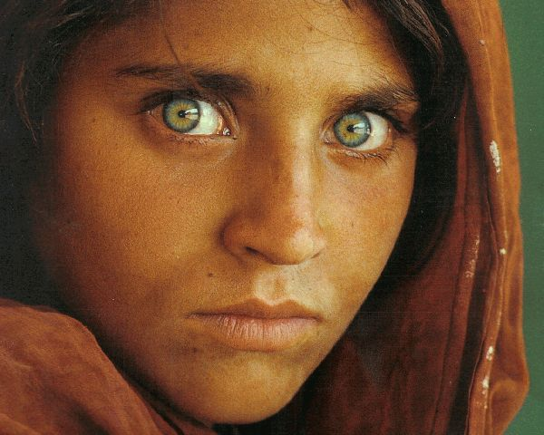
Orientalism
Edward Said Orientalism 1978
A comparison across cultures where the west is ALWAYS seen as superior
For example, what are common images of people from the east and from Afghanistan in particular?
Exotic
Barbaric
Uncivilized
Less ethical
Religious Fanatics
What else?

Slide 16
Culturalism
Mahmood Mamdani: The tendency to see the problems of other cultures as an endemic cultural trait rather than a political problem.
“These people are incapable of just rule. They are a bunch of barbarians.”
Problems around the globe are presented ahistorically and without attention to geopolitics.

Slide 17
Racism
There are lots of ways in which subtle racism persists in various ways in our society.
Teaching about different cultures can often lead to the presentation of other cultures as static.
Cultural explanations for differences can lead to student perceptions that inequalities are the result of cultural difference and not a structural part of society.
But being “colorblind” erases the lived experiences of different groups and ignores diversity.

Slide 18
Challenges to Empathy
Empathy is not natural. It takes hard work.

Slide 19
Global Connections or Global Contrasts?
Teaching global cultures runs risks.
Not teaching global cultures runs risks.
How can we best face these challenges?

Slide 20
CMLIT 143: Human Rights and World Literature
Use the history of human rights and the storytelling modes essential to it to build cross-cultural sensitivity, global perspectives, and ethical awareness.

