Slide 1
Can You Hear Me Now? E(h)co-location to Bridge the Gap Between Advisers, Underrepresented Minority, and International Students
Presentation by Dr. Jason E. Gines & Olivia K. Lewis

Slide 2
Advanced Organizer
Introductions
Case Study Primers
Ec(h)olocation Definitions
Impact of Bias
Brief Theory Overview
Ec(h)o-location Model
Case Studies
Questions

Slide 3
introductions
Jason Gines, Ph.D. (he/his/ze)
Director, Inclusion and Diversity Engagement
jeg293@ist.psu.edu
Olivia Lewis (she/her/hers)
Coordinator, Inclusion and Diversity Engagement
okl1@psu.edu
E101 Westgate Building
Student Academic Services
Notes:
Introductions
The goal of this session is to offer tools for you to use as you encounter the increasingly diverse and complex student population entering higher education. We want to bridge the gap in communication. We recognize that you have been advising students for many years and we hope to add to your toolkit.

Slide 4
Primers for case studies
Case Study #1: Regina
Case Study #2: Gerald
Which attributes are most salient?
Notes:
Case study primers are designed to give you a sense of the students who attend the university and the complexity of their issues and attributes.
These are snippets from the full case studies but we can see the depth of individuals. The layers. So then what is eco-location?

Slide 5
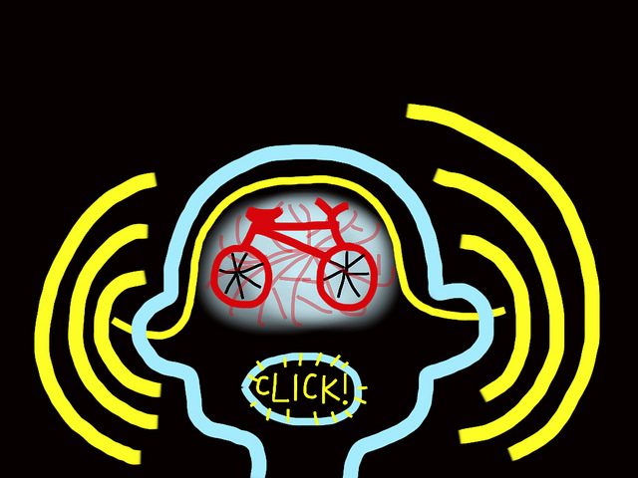
Ec(h)o-location
Definitions
physiological process for locating distant or invisible objects by sound waves reflected back to the emitter from the objects (https://www.merriam-webster.com/dictionary/echolocation)
Ec(h)o-location Adapted Definition
Communicative process for locating intersecting visible or invisible identities by utilizing dualistic reflection that provides a culturally holistic view of the subject (Gines, 2017)
Notes:
Echo-location can be found in the animal world. Creatures like bats, dolphins, whales, send out signals which then hit an object and bounce back to the originator. These sound waves are unique in that they tell the animal how far away an object is and how its shaped.
Tying this to the higher education context, (adapted definition). To break that down, eco-location is a communicative process which strives to reveal identities, visible or invisible, and their intersections using a dualistic reflection to provide a holistic view of the subject.
Dualistic reflection in this model is critical because we are contextualizing our own visible and invisible identities and we need to be aware of how those identities are impacting how we view others.
Dualism:
1: a theory that considers reality to consist of two irreducible elements or modes
2: the quality or state of being dual or of having a dual nature

Slide 6
Bias & unconscious bias
“blind spots”
“Being biased is how we get through life without evaluating everything afresh every time we experience it”
– Howard J. Ross
We are exposed to 11 MILLION sensory triggers at one time…We can only absorb 40-50…We can consciously notice as few as 7 at a time.
Given the immense amount of stimuli we are exposed to at any one particular moment, how can we know what we are responding to?
9
Office of Inclusion & Diversity Engagement
Notes:
As we reflect upon ourselves, we need to acknowledge that if we are breathing, we are biased.
Bias Example Case: A man and his son get on an airplane. The plane takes off and shortly thereafter is hit by a tremendous storm, which causes a crash landing. The father is killed instantly, but, miraculously, the son is injured but survives. An ambulance rushes him from the scene to the local hospital, where he is immediately taken to the operating room. After the boy is prepped for surgery, the surgeon approaches the operating table but then stops suddenly and says, “I can’t operate on this boy---he is my son!” Who is the surgeon? (xix)
“We are constantly making decisions that are influenced by unconscious biases. In fact, even when our biases seem conscious, they may be influenced by a pattern of unconscious assumptions that we have absorbed throughout our lives. It is like a polluted river. We may do everything we can to clean the river as it flows downstream, without having any consciousness about the pollutants that are being dumped in it by a factory or sewage plant upstream.”

Slide 7
Impact of Bias
Types of Unconscious Bias
Selective Attention: a mental process through which we selectively see some things but not others depending upon our point of focus, or what we happen to be focusing on at a particular time.
Diagnosis Bias: the propensity to label people, ideas, or things based on our initial opinions
Halo/Horn Effect – our initial impression of people impact every subsequent interaction with them. Several studies show that his initial impression is lasting, and tends to produce Confirmation Bias.
Pygmalion Effect & Galatea Effect: Receiving information on someone can “prep” the mind to fill in the blanks with certain stimuli
Notes:
This is why the eco-location model calls for dualistic reflection. The first step in culturally holistic viewpoints is the recognition that I am most likely harboring unconscious bias that is impairing my ability to fully eco-locate the consumer.

Slide 8
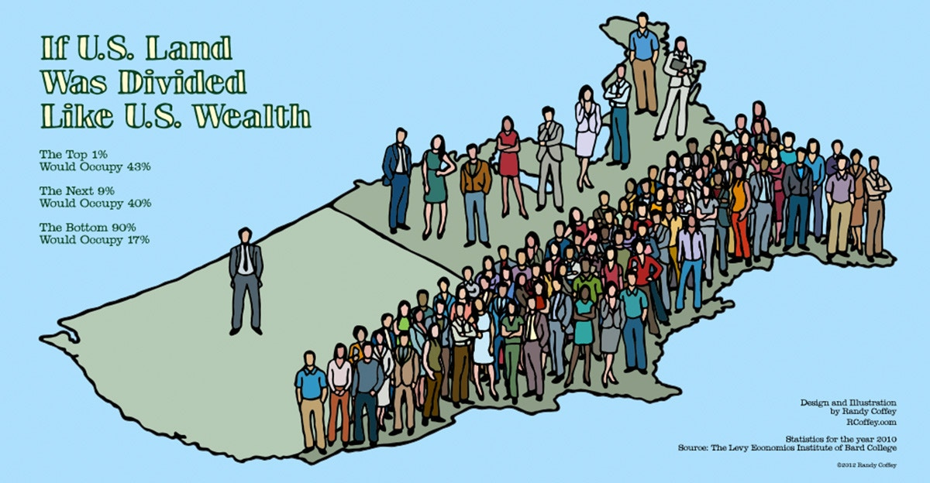
Brief Theoretical Overview
Social Location
Where individuals are situated in relation to others (e.g., disability status, race, ethnicity, citizenship status, etc.)
Social locations relate to stratification (at local, national and transnational fields), within a contextual and chronographic context, i.e. they inhabit a ‘real time and place’ context.
Notes:
Every day, we all have information coming at us all at once and the filters we use to sort through and make sense of that information shapes our bias. It is our social location which defines the filters we use everyday.
Social location is where we are positioned in society and in history based on these attributes. Gender, race, socioeconomic status, ability, sexual orientation, etc. all come together to determine where we are situated in relation to one another and how we view the world.
For example, this graphic. How differently do you think each of these individuals view the world. Top corner represents the top 1% of the population would occupy 43% of the land. The next 9% would occupy 40% of the land. The bottom 90% of the population would only occupy 17% of the land.
Especially important today is this social context.
Our ‘location’ is embedded in relations of hierarchy within a multiplicity of specific situational and conjunctural spheres… [which determine] broader landscape[s] of power which is productive of social divisions and does not remain fixed on the manifestations of the latter.

Slide 9
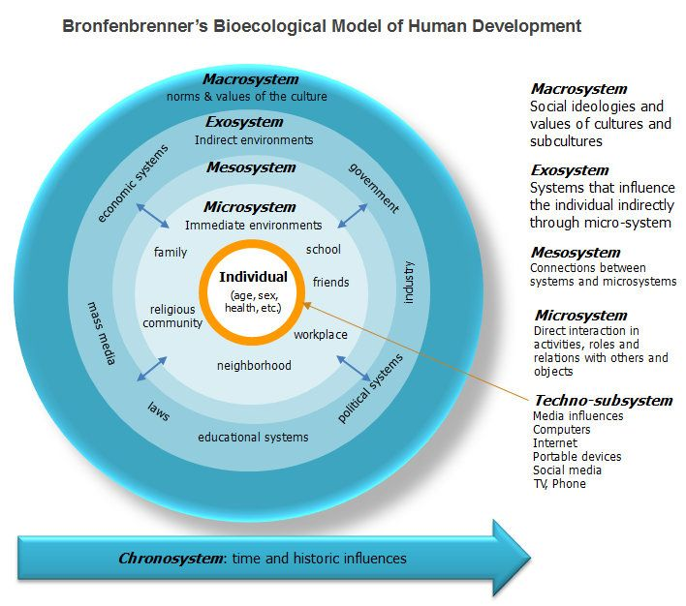
Brief Theoretical Overview
Ecological Model
Notes:
Bronfenbrenner’s bio-ecological model applies context to development theory.
Starting with the individual, the first layer is the microsystem. These are direct interactions with the immediate environment. For example, family, friends, school. I want to point out, these interactions and relationships are more salient for some individuals. There could be a cultural piece to that. For students in a university environment, that could be roommates.
The mesosystem is the bridge that connects the inner to the outer systems. For example, communities surrounding the university. They are not part of the microsystems but impact students’ experiences at Penn State.
The exosystem influences the individual indirectly. Mass media, laws. That could be changes instituted at the university that impact a student.
The macrosystem is the overarching bubble that includes norms and values of society as a whole.
At any point in time, students are being pressed by one or more of these systems.
The final dimension is the chronosystem. Where is that individual in time. What is happening in society which impacts students both directly and indirectly.
Why do these pieces matter? If we look at Baxter Magolda’s theory of self-authorship, during their time at Penn State students are asking, “How do I know?”, “Who am I?”, and “How do I want to construct relationships with others?”
As students move from Phase 1 where they are following the direction set for them by parents and teachers to a more actualized sense of self, disruptions in any of these systems will throw off a student’s development.
We see these influences now. Nationwide we are having difficult conversations. International students are wondering whether they will be able to stay in school. That can affect their ability to concentrate. They may be more distracted in class, grades may slip. That could impact funding. They could be facing discrimination from classmates or roommates.

Slide 10
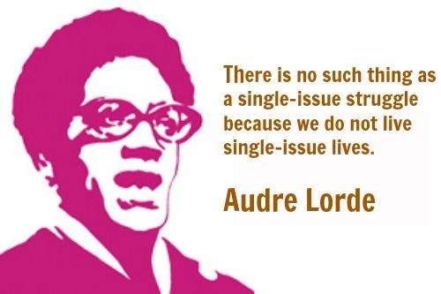
Brief Theoretical Overview
Intersectionality
The recognition of multiple interlocking identities that are defined in terms of relative sociocultural power and privilege and shape peoples’ individual and collective identities and experiences (Shields 2008)
Notes:
Intersectionality reinforces that we are multi-layered beings. This quote by Audre Lorde says it all, “There is no such thing as a single-issue struggle because we do not live single-issue lives.”
What is especially important about intersectionality is some statuses override the privilege of other attributes.
”The recognition of multiple interlocking identities that are defined in terms of relative sociocultural power and privilege and shape peoples’ individual and collective identities and experiences”

Slide 11
Brief Theoretical Overview
Minoritization of groups
The United States Census Bureau projects that over the next 20-30 years, “more than half of all Americans are projected to belong to a minority group,” further, “by 2060, nearly one in five of the nation’s total population is projected to be foreign born”
(Colby & Ortman, 2014, p. 1).

Slide 12
Brief Theoretical Overview
Minoritization
“A population is a minority if it occupies some form of subordinate power position in relation to another population within the same country or society.” (Ogbu & Simons, 1998, p. 162)
Autonomous
Voluntary (Immigrant)
Involuntary (Nonimmigrant)
Groups small in number
Difference includes race, ethnicity, religion, or language from majoritized group
U.S. context: Amish, Jews, and Mormons
Immigrant groups seeking better opportunities
Difference includes race, ethnicity, religion, or language from majoritized group
No interpretation of presence as forced upon them by U.S. Government or White Americans (Refugees fit this category)
People with a legacy of colonization and enslavement
Introduced to U.S. society permanently against their will
Interpretation of presence in the U.S. as forced on them by White people (Native, Mexican, African Americans, Native Hawaiians and Puerto Ricans)
Notes:
Autonomous: Amish Rumspringa. They can change their clothing and fit into the majoritized groups. They “pass.”

Slide 13
Ec(h)o-Location Model
BioEcological Mapping
1) Dualistic Reflection
2) System Evaluation
3) Hierarchical Forces
Social Locating
1)Comparative Force Analysis
2) Context Analysis (local, state, national, international)
Identifying Intersections
1) Additive Oppressed and/or Marginalized Identities
2) Contextualize Daily Struggles
Minoritization
1) Social Realities of Identified Status
2) Intergroup vs. Intragroup dynamics
Notes:
This is why the eco-location model calls for dualistic reflection. The first step in culturally holistic viewpoints is the recognition that I am most likely harboring unconscious bias that is impairing my ability to fully eco-locate the consumer.

Slide 14
Ec(h)o-Location Model
Case Studies
For both cases:
Utilize the Eco-location model to identify critical issues to be addressed for both individuals.
Discuss potential barriers (seen and unforeseen) based on information acquired from the model.
Given the context in which you work, what are steps you would take that are different than what you currently do?
Notes:
Split into groups.

Slide 15
Questions?

Slide 16
References
Anthias, F. (2013). Hierarchies of social location, class and intersectionality: Towards a translocational frame. International Sociology, 28(1), 121-138.
Anthias, F. (2013). Intersectional what? Social divisions, intersectionality and levels of analysis. Ethnicities, 13(1), 3-19.
Bronfenbrenner, U. (1977). Toward an experimental ecology of human development. American Psychologist, 32(7), 513.
Bronfenbrenner, U. (2009). The ecology of human development. Harvard university press.
Carbado, D. W., Crenshaw, K. W., Mays, V. M., & Tomlinson, B. (2013). Intersectionality. Du Bois review: Social science research on race, 10(2), 303-312.
Crenshaw, K. (1991). Mapping the margins: Intersectionality, identity politics, and violence against women of color. Stanford law review, 1241-1299.
Cramer, E. P., & Plummer, S. B. (2009). People of color with disabilities: Intersectionality as a framework for analyzing intimate partner violence in social, historical, and political contexts. Journal of Aggression, Maltreatment & Trauma, 18(2), 162-181.

Slide 17
References
Ogbu, J. U., & Simons, H. D. (1998). Voluntary and involuntary minorities: A cultural‐ecological theory of school performance with some implications for education. Anthropology & Education Quarterly, 29(2), 155-188.
Patton, L. D., Renn, K. A., Guido, F. M., & Quaye, S. J. (2016). Student development in college: Theory, research, and practice (3rd ed.). San Francisco, CA: Jossey-Bass.
Ross, H. J. (2014). Everyday bias: Identifying and navigating unconscious judgments in our daily lives. Lanham, MD: Rowman & Littlefield.
Shields, S. A. (2008). Gender: An intersectionality perspective. Sex roles, 59(5-6), 301-311.

