Slide 1
SmarterMeasure Consultation
Conversations About Non-cognitive Factors & Academic Success

Slide 2
Presenters
Michelle Wiley, M.Ed., Assistant Director, Academic Development Services, Penn State World Campus
Kim Wiesner, M.Ed., Student Success Coordinator, Academic Development Services, Penn State World Campus

Slide 3
Key Problem
Many students are not prepared for the distance education “classroom experience” which is most likely, completely different from any educational experience they have known.
It is important to consider that adult students bring their social world and the prior knowledge with them to the virtual classroom (Lave, 2011) and expect both to be acknowledged and appreciated by peers and staff.
First-time in college adult students, need a roadmap that outlines how to navigate the process of being a college student who is studying from a distance.
Notes:
Michelle
Students only have their experience with traditional education (on some online classes) and are not prepared for asynchronous DE.
Adult students bring a wealth of experience to the classroom which helps them make sense of new material.
New students need a GPS to navigate the DE experience.

Slide 4
World Campus Population
78.3% (n=11,965) adult learners
74.4% between ages of 24-39
34.8% married
32% have children
3.9% veterans
2.3% active military
30% (n=5318) first generation learners
69.4% (n=5318) concerned about having time for school
Sources: Pennsylvania State University, World Campus Adult Learner Dashboard (2021a).
Pennsylvania State University, World Campus Adult Learner Dashboard (2021b).
Pennsylvania State University, World Campus Academic Development Services (2021).
Notes:
Michelle
Here is a snapshot of the student population at WC.
Focus on 24 and older; other factors that put students into the "adult" category

Slide 5
Objectives
Recognize what the SmarterMeasure assessment reveals about a student’s non-cognitive strengths and opportunities for improvement.
Identify non-cognitive factors and skills that transcend academic settings.
Recognize the importance of explaining What, How, and Why of resources.
Discuss the benefits and challenges of 1:1 consults.
Recognize how consults can influence student performance and increase retention.
Notes:
Michelle – The objectives for our presentation today include:
1. What do the results of the assessment tell us?
2. NC factors that play a role in both DE and traditional education settings
3. Explain what the resource is and how to use it. Explain why it is important – how will they use it throughout college
4. The good, bad and ugly of the consultation... it's not perfect
5. Positive impacts of the consultation

Slide 6
SmarterMeasure Assessment
Content
Life Factors
Individual Attributes
Technology Knowledge & Competency, LMS Competency
Learning Styles
Reading Recall
Typing
Notes:
Michelle
The assessment measures several areas
Life Factors: Time, Place, Resources, Skills (right now)
Individual Attributes: Academics (previous), help seeking, persistence, procrastination
Tech: browsers, apps, spreadsheets, access, LMS (Canvas, D2L)
Learning Styles:
Reading: Rate and Recall
Typing: Speed and Accuracy
Kim will now go into further details about th

Slide 7
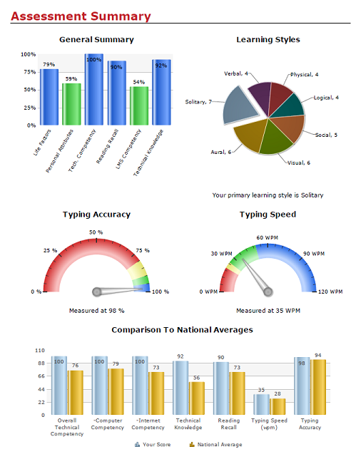
Non-cognitive Factors that Transcend Academic Settings
Time for school
Place to study
Reason for school
Supportive resources
Perceived academic skills
Help seeking
Persistence
Procrastination
Time management
Locus of control
Notes:
Michelle

Slide 8
Key Factors that Align with First Year Success at World Campus
Academic Skills
Typing
Reading
Technical Vocabulary
Source: OAR-12084, 2019
Notes:
Michelle – Kim begin next slide
We have collected data that should the four areas listed about can have a significant impact on a student's success during their first year at Penn State World Campus.
Kim will now go into further details about the assessment and consultation, explaining how we use the data to support our students.

Slide 9
Consultation Outreach
All students completing SmarterMeasure receive invitation for consult.
Students with 3 or more flags receive up to 2 additional emails.
Approximately 12.5% of all students schedule a consult.
340 consults completed since October 2019
7.6% of all students completing SmarterMeasure assessment
Source: Pennsylvania State University, World Campus Academic Development Services (2021).
Notes:
Kim
WC has been using SM for 10 years now and we have more than 22,000 students who completed the assessment.
We regularly analyze data and set threshold scores for each SM component.
Every Tuesday we receive a summary report from our analytics department.
The report includes all students completing SM for the prior 7 day period, and scores that fall below threshold are flagged.
All students with 1 or more flag(s) receives an email invitation to schedule a SM consult.
Students with 3 or more flags can receive 2 additional emails spaced a week apart - encouraging them to schedule a consult.
Approximately 12-13% of all students completing SM schedule a consult.
Since October 2019, we have completed 340 consults – which equates to approximately 7.6% of all students completing SM.

Slide 10
Consultation with Students
Opportunity to engage students in conversations about their academic pursuits and begin thinking about resources to help them succeed.
Inquire about student concerns.
Review each section, query student about flags.
Ask open-ended questions.
Utilize active listening techniques.
Notes:
Kim
Consults provide an opportunity to engage students in conversations about their academic endeavors.
Consult encourages students to be proactive and begin thinking about supportive resources before classes begin.
Consults create a space for students to ask questions and share concerns.
During the consult:
We inquire about student concerns.
We review each section of SM as time permits.
Prioritize flags to ensure we provide essential resources for student success.
Important to review each section – even if student scored above threshold – can reveal areas of concern.
For example, student scored above threshold in procrastination and time mgmt. but had concerns about delaying writing papers because they disliked writing.
Had discussion about productivity tools: Pomodoro Technique and Kanban Method.
We ask open-ended questions.
Students may reveal learning or physical disabilities – opportunity to make referral to Disability Services
For example, when asked about his typing results, a student shared how he severely damaged one hand in car accident – still able to type but only for limited amount of time
Had discussion about dictation feature in MS Word & Google Docs, and made referral to SDS for accommodations
We utilize active listening techniques.
Build trusting relationship with students can instill confidence to reach out when help is needed.

Slide 11
Resources
Academic Success Kit
Time Management
Note-taking
Exam Prep
Group Work
Using Syllabus
Typing Club
MS Word & Google Docs Dictation
Active Learning Strategies: SQ3R & SOAR
PSU Library Information Literacy Modules
Productivity Tools (Pomodoro & Kanban)
Tech Tutors & Technical Support
Adult learners want to know What, How & Why regarding resources.
What is the resource?
How does they use it?
Why should they use it?
Notes:
Kim
Through the consultation process, we learned that adult learners want to know the What, How & Why of resources.
WHAT is the resource?
HOW do they use the resource?
WHY should they use the resource
Case in point - in the previous example where the student expressed concern about procrastinating with writing papers. We recommended the Pomodoro Technique. We described the Pomodoro Technique (WHAT is it?), then discussed how the tool can be used to overcome procrastination (HOW is it used?) and explained that Pomodoro is a useful tool to overcome the primary barrier with procrastination – getting started (WHY should it be used?).
We follow this up by sending the student link(s) to video’s about Pomodoro as a tool to overcome procrastination as well as a video on using it as a productivity tool.
Some of our primary resources we share with students include:
Our Academic Success Kit - which includes modules we built on topics ranging from Time Management, to Note-taking, to Exam Preparation, and Group Work.
Typing Club and MS Word & Google Docs dictation tools
Active Learning Strategies SQ3R (Survey, Question, Read, Recite & Review) and SOAR (Select, Organize, Associate & Regulate)
PSU Library Information Literacy Modules
Productivity Tools (Pomodoro & Kanban)
Tech Support & Tech Tutors

Slide 12
SmarterMeasure Consultation
Pro’s
Con’s
Opportunity to ask questions/share concerns
Discuss flags & identify specific resources
Reveal factors not identified by assessment (i.e., referrals to SDS)
Equip student with tools to help build skills
Provide support early in student's academic career
Build relationships
Outreach takes time.
65% schedule after 2nd email.
Consultations take 45-60 minutes.
Students self-select consult.
Many who could benefit, don’t participate.
Notes:
Kim
PRO’s
Consult creates a space for students to ask questions and share concerns.
Opportunity to discuss flags and identify resources specific to their needs.
Thinking about needs and resources before school begins enables student to make study time more efficient.
For adult learners, discussions centered on ways to make study time more efficient can be a cornerstone to academic success.
The consult may reveal factors not identified by the assessment.
Physical and mental health concerns.
We can equip students with tools to help build skills
Typing club
Active learning & note taking strategies
Provide early support in student’s academic career so they gain confidence in their skills and reduces anxiety/stress.
Build a relationship with student so they are comfortable reaching out for assistance.
CON’s
Outreach takes time
Most students do not respond to the initial email
65% of scheduled consults occur after second email is sent
Consultations take time
Consultations are a process involving multiple steps including preparation, meeting with student, sending post-consult resources, and documenting in Starfish.
The entire process can take 45-60 minutes per consult.
Some students require multiple meetings.
Students self-select the consult – those who may benefit, don’t participate.
Many students with 3 or more flags don’t participate in the program.

Slide 13
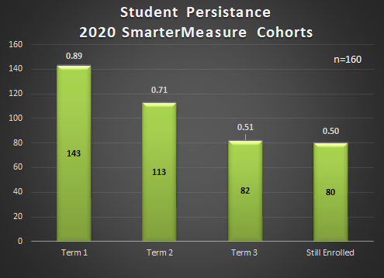
Outcomes - Persistence
SmarterMeasure Consults Student Persistence Rates
Total 2020 cohort = 160
SP20 = 44
SU20 = 43
FA20 = 69
SP/SU21 = 4
Notes:
Student persistence is determined by the number of terms the student completed since enrollment.
4 students delayed their start until 2021
89% of the cohort completed 1 term
71% of the cohort completed 2 terms
51% of the cohort completed at least 3 terms
50% of the cohort is still currently enrolled in classes FA21

Slide 14
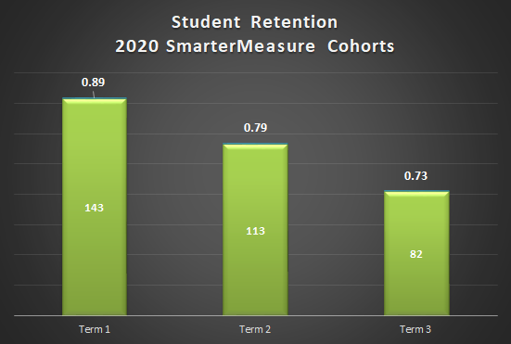
Outcomes - Retention
SmarterMeasure Consults Student Retention Rates
Total 2020 Cohort = 160
Term 1 - Term 2 = 79%
Term 2 - Term 3 = 73%
WC Average Next Term Retention Rate (2013-2020) = 74.5%
Notes:
Kim
It is still too early to see the effect of the consults on student persistence and retention.
Early data indicate there may be increased retention with students completing the consult.
So, student retention is measured as the number of consecutive terms the student has completed since enrollment.
NOTE: Summer terms may not be counted as consecutive if the student completed both the successive SP and FA terms.
The 2020 SM Consult cohort includes 160 students.
The next term retention rate for this cohort is 79%.
The WC average next term retention rate for 2013-2020 is 74.5% so we are slightly above that value.
Additionally, the 2020 SM consult cohort retention rate for the third term is 73%.

Slide 15
Student Feedback
Post-consult Survey (p=32.1%)
93% indicated assessment useful for identifying Strengths & Opportunities for improvement
82% found ASK modules very or extremely useful
84% found Library Resources very or extremely useful
83% found Technology resources very or extremely useful
Notes:
Kim
Student feedback is the current measure of success for the SM consultations.
Approximately 7-10 days after the consult, the student receives an email requesting they complete a short survey about the SM consultation.
The response rate is approximately 32.1%
93% of the students surveyed indicated the SmarterMeasure assessment was useful for identifying their strengths and opportunities for improvement
There are several questions about the resources we share with students after the consult. Using a 5-point Likert scale, students are asked to rate the usefulness of the resources.
82% scored the Academic Success Kit modules very or extremely useful
84% scored the Library resources very or extremely useful
83% scored the Technology resources very or extremely useful

Slide 16
Student Comments
"The assessment was helpful but what I found most useful was the consultation right after. I wished I could have had that meeting sooner."
"I think that the SmarterMeasure assessment and consultation is a great resource, and it is wonderful that Penn State invests in this kind of support for its online community of students."
"I think this is a great help to students...in my case, it gave a returning student some peace of mind that there is help if we need it..."
"Thanks so much for taking the time to do this...after the experience that I've had with SmarterMeasure any type of student would benefit from it in many ways."
Notes:
Kim
There are several sections in the survey where students can include additional feedback about the assessment, resources, or consult.
Some feedback we received include
Consultation is useful & appreciated
Consult helps give students peace of mind, confidence, and reduces anxiety
New students, returning students, first generation students find the assessment and consult a benefit

Slide 17
What next?
Analyze academic performance of students completing consults.
Evaluate use of resources such as Tutor.com, Math Essentials, ASK modules.
Analyze involvement in special programming such as Smart Track.
Notes:
Kim
We believe we have sufficient evidence that the SM assessment and consult are beneficial to students.
Our next steps with this program are to:
Analyze the academic performance of students completing the SM consult and compare to students who have not participated in the consult
Evaluate the use of resources including tutoring, math support programming, and ASK modules
Analyze student outcomes when they also participate in special programming such as Smart Track

Slide 18
Questions?
Contact Information
Michelle Wiley: mcw22@psu.edu
Kim Wiesner: kaw371@psu.edu

Slide 19
References
Lave, J. (2011). Everyday Life and Learning with Jean Lave. At the University of California, Berkeley [video] https://youtu.be/FAYs46icCFs
OAR-12084. (2019). SmarterMeasure Evaluation Update. Internal Outreach Analytics & Reporting report: Unpublished.
Pennsylvania State University, World Campus Adult Learner Dashboard (2021a). Adult Learner Demographics [Data file]. Retrieved from https://pennstateoffice365.sharepoint.com/sites/AdultLearnerDashboard
Pennsylvania State University, World Campus Adult Learner Dashboard (2021b). Adult Learner Headcounts: 2020 Academic Year: World Campus [Data file]. Retrieved from https://pennstateoffice365.sharepoint.com/sites/AdultLearnerDashboard
Pennsylvania State University, World Campus Academic Development Services (2021). Academic Success Kit. Retrieved from https://sites.psu.edu/prepkit/
Pennsylvania State University, World Campus Academic Development Services. (2021). SmarterMeasure WC UGRD Outreach & Consult Tracking [Department data file].

